Slide 1
Formal Methods in Software Engineering
Formal Reasoning

Slide 2
Formalization and Reasoning
Formal reasoning provides tradeoffs
  Establish truth for many (possibly infinite) cases
  Know properties ahead of time, before object exists
  Requires abstract reasoning and careful thinking
  Need basic truths and rules for combining truths
Today: develop formal reasoning for programs
  What is true about a program’s state as it executes?
  Two flavors of reasoning: forward and backward

Slide 3
Reasoning About Programs
What is true of a program’s state as it executes?
  Given initial assumption or final goal

Slide 4
Reason About Programs?
Essential complement to testing
  Testing shows specific result for a specific input
Proof shows general result for entire class of inputs
  Guarantee code works for any valid input
  Can only prove correct code, proving uncovers bugs
  Provides deeper understanding of why code is correct

Slide 5
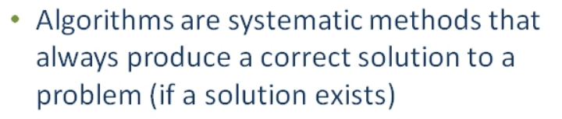
Formal Reasoning

Slide 6
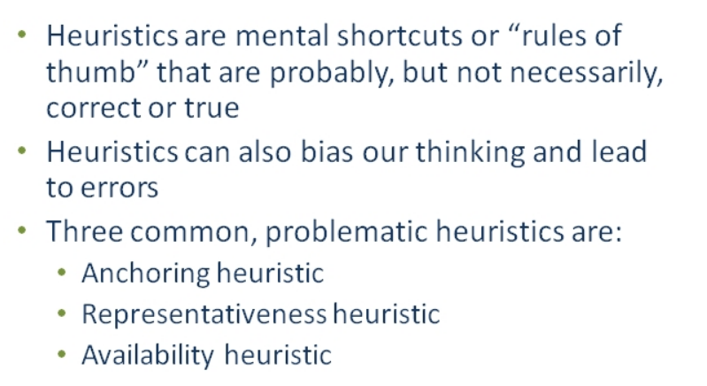
Informal Reasoning

Slide 7
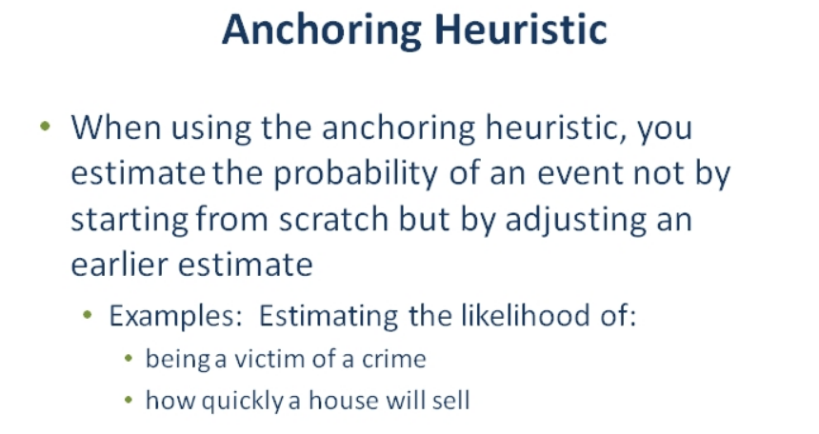

Slide 8
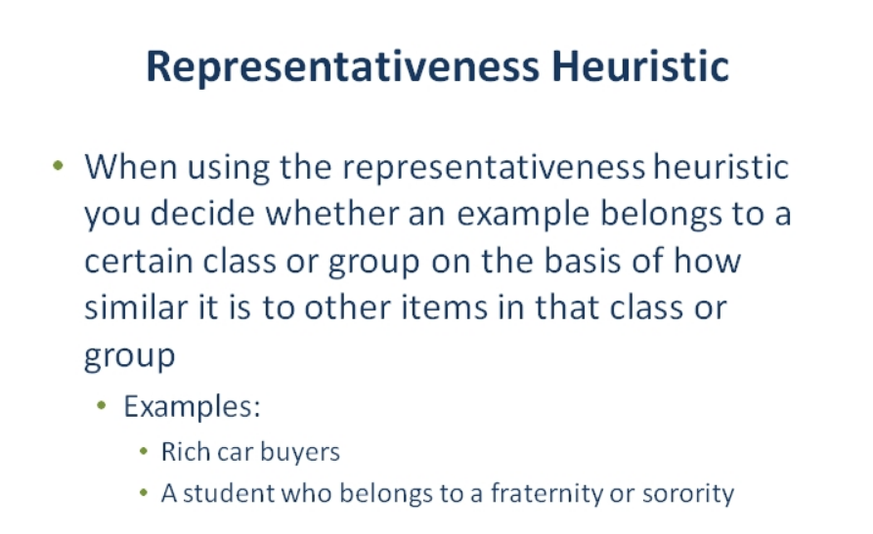

Slide 9
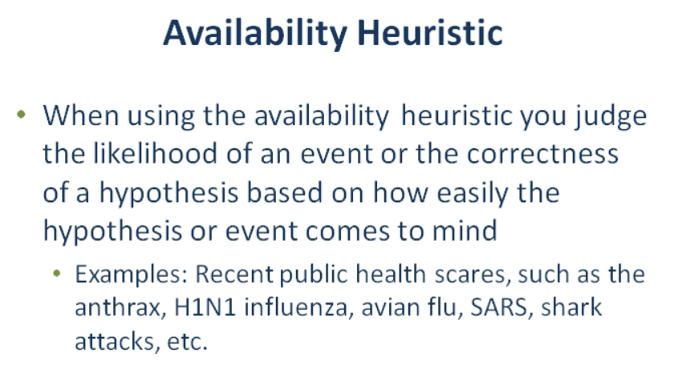

Slide 10
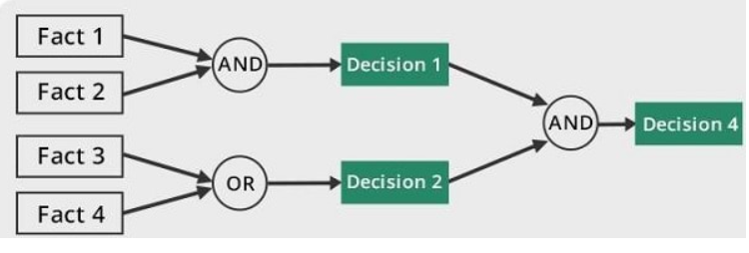
Forward Reasoning
Forward chaining is a method of reasoning in artificial intelligence in which inference rules are applied to existing data to extract additional data until an endpoint (goal) is achieved.

Slide 11
Forward Reasoning Example
Suppose we initially know (or assume) w > 0
// w > 0
x = 17;
// w > 0 ∧ x == 17
y = 42;
// w > 0 ∧ x == 17 ∧ y == 42
z = w + x + y;
// w > 0 ∧ x == 17 ∧ y == 42 ∧ z > 59
…
Then we know various things after, e.g., z > 59

Slide 12
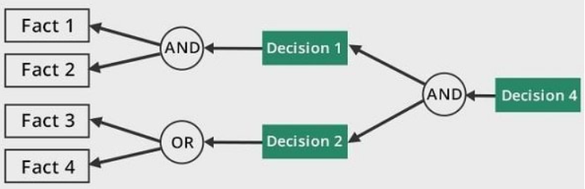
Backward Reasoning
Backward chaining is a concept in artificial intelligence that involves backtracking from the endpoint or goal to steps that lead to the endpoint.
This type of chaining starts from the goal and moves backward to comprehend the steps that were taken to attain this goal.

Slide 13
Backward Reasoning Example
Suppose we want z < 0 at the end
  // w + 17 + 42 < 0
x = 17;
// w + x + 42 < 0
y = 42;
// w + x + y < 0
z = w + x + y;
// z < 0
Then initially we need w < -59

Slide 14
Forward vs. Backward
Forward Reasoning
  Determine what follows from initial assumptions
  Simulates the code for many inputs at once
  May feel more natural
Backward Reasoning
  Determine sufficient conditions for a certain result
  Often more useful, shows how each part affects goal
  May feel unnatural until you have some practice

